Slide 1
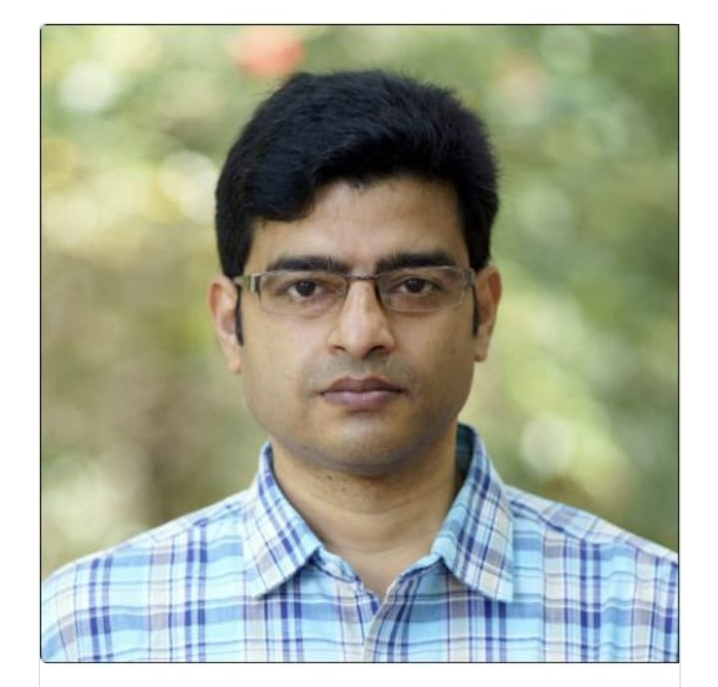
Calcutta University
Bachelor of Science , Physics 2001 - 2004
Sayantan Majumdar
Associate Professor, Soft condensed matter
Raman Research Institute, Bengaluru
Department of Physics

Slide 2
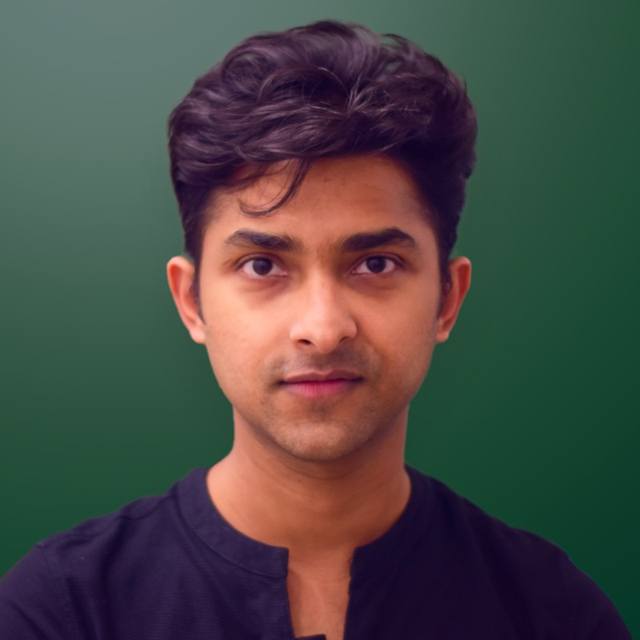
Calcutta University
Bachelor of Science , Physics 2011 - 2014
Sayantan Saha
Marketing Manager @ Starkflow | MBA in Marketing

Slide 3
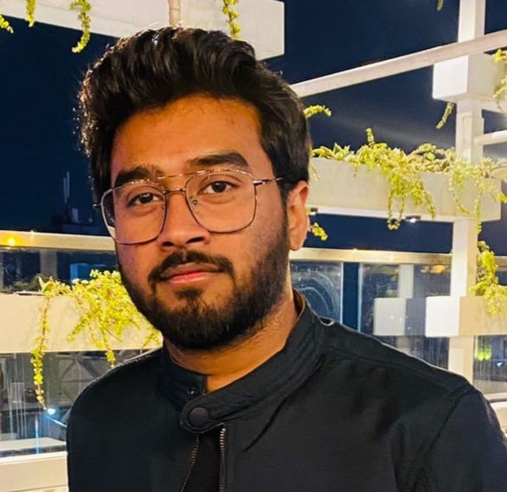
Calcutta University
Bachelor of Science , Physics 2015 - 2018
Banadeep Dutta
Ph.D. Research Scholar (INSPIRE Fellow) at IIT Indore (2022-present)
Department of Physics

Slide 4
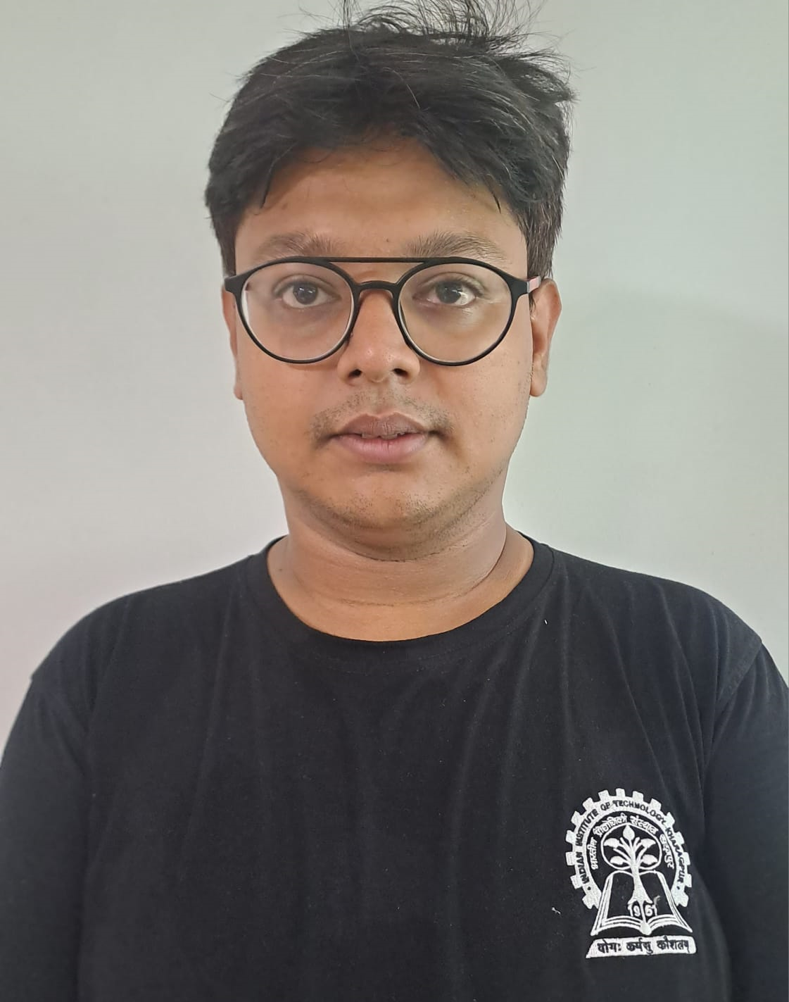
Calcutta University
Bachelor of Science , Physics 2016 - 2019
Subhobrata Banerjee Persuing Joint M.Tech/MCP-PhD Programme 2023 at IIT KGP
Department of Physics

Slide 5
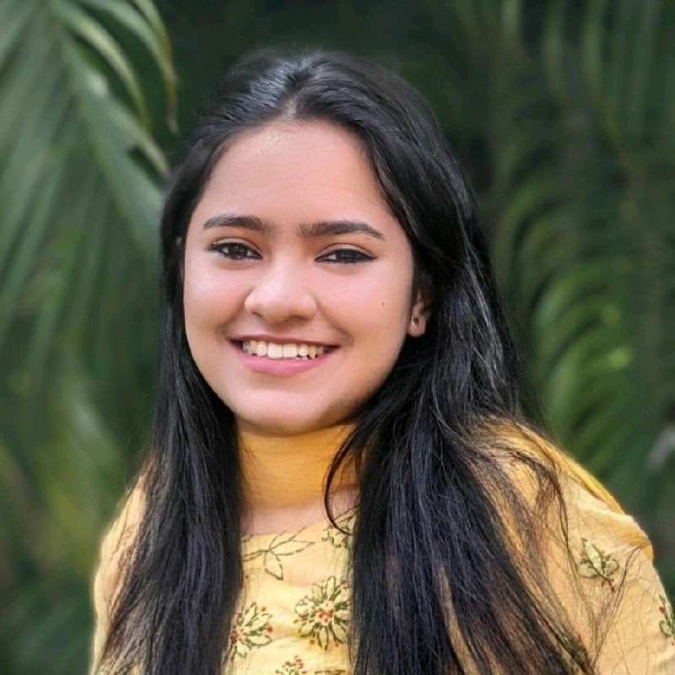
Calcutta University
Bachelor of Science , Physics 2017 - 2020
Imamah Ali Master of Science - MS, University of Calcutta, 2022
Currently PhD Research Scholar | Atmospheric Physics and Meteorology |National Institute of Technology Rourkela
Department of Physics

Slide 6
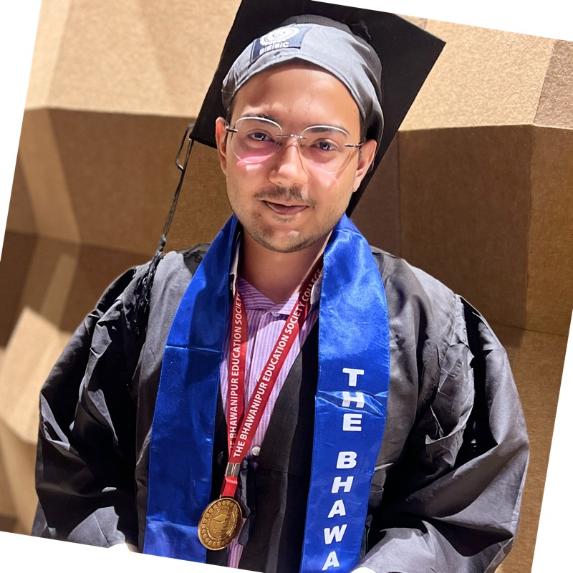
Calcutta University
Bachelor of Science , Physics 2018 - 2021
Sandeepan Ganguly
Hofstra University, New York
Master of Science - MS, Medical Physics
Sep 2022 - May 2024
Currently Admin Intern in Northwell Holdings · Full-time
Department of Physics

Slide 7
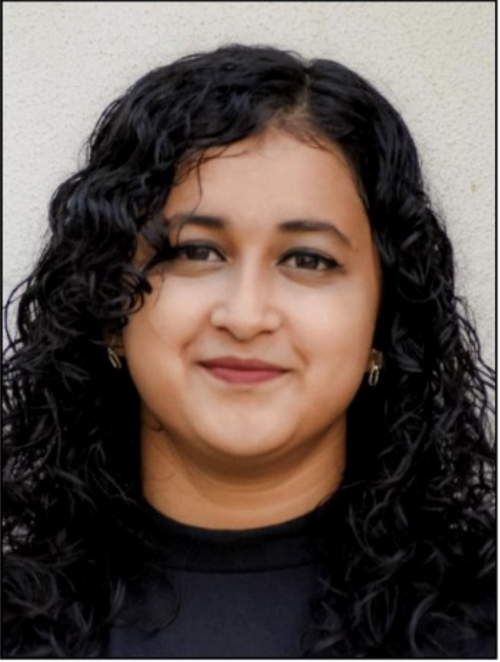
Calcutta University
Bachelor of Science , Physics 2019 - 2022
Ishika Das
pursued an MSc in Optoelectronics and Quantum Technology at the University of Bristol, UK.
Currently enrolled in a PhD program in Photon Physics at the University of Manchester, supported by the prestigious Dean’s Scholarship.
Department of Physics

Slide 8
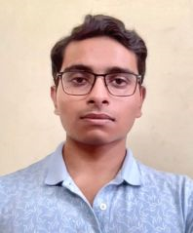
Calcutta University
Bachelor of Science , Physics 2019 - 2022
Souradipta Roy
(Entrepreneur)
Managing Director
Envotech Advertising Solutions Private Limited
Currently pursuing 1 year MSc in Sustainability, Energy and Development at Durham University, UK.
Department of Physics

Slide 9
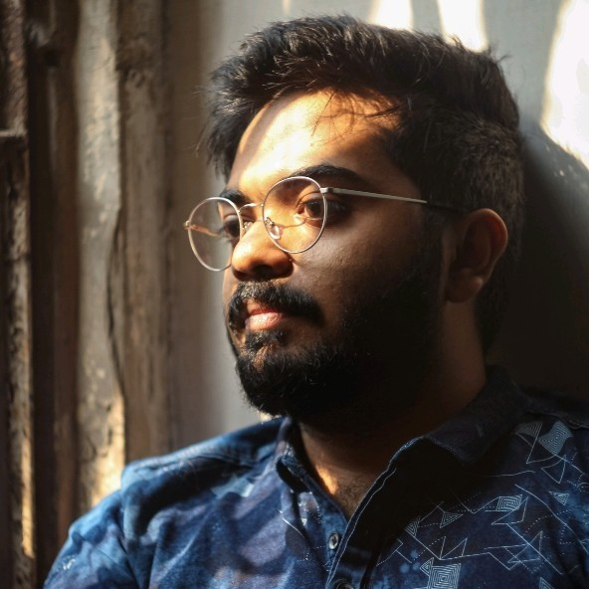
Calcutta University
Bachelor of Science , Physics 2019 - 2022
Abhinaba Upadhyay
NIT Jalandhar
Master of Science - MS, Physics 2022 – 2024
Currently engaged in Research
Dr. B R Ambedkar National Institute of Technology, Jalandhar ( PUNJAB)
Department of Physics

Slide 10
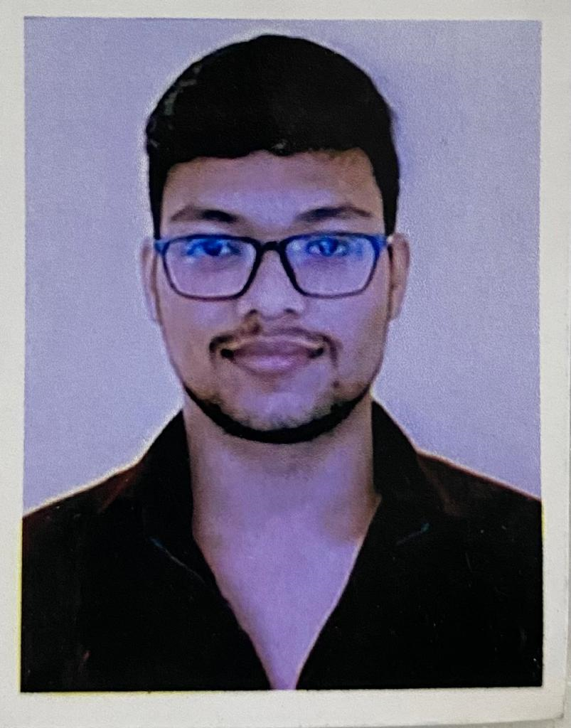
Calcutta University
Bachelor of Science , Physics 2020 - 2023
Rituraj Sarkar
Cracked IIT JAM in 2023
Currently pursuing Master degree from NIT Jamshedpur.
Department of Physics

